Slide 1
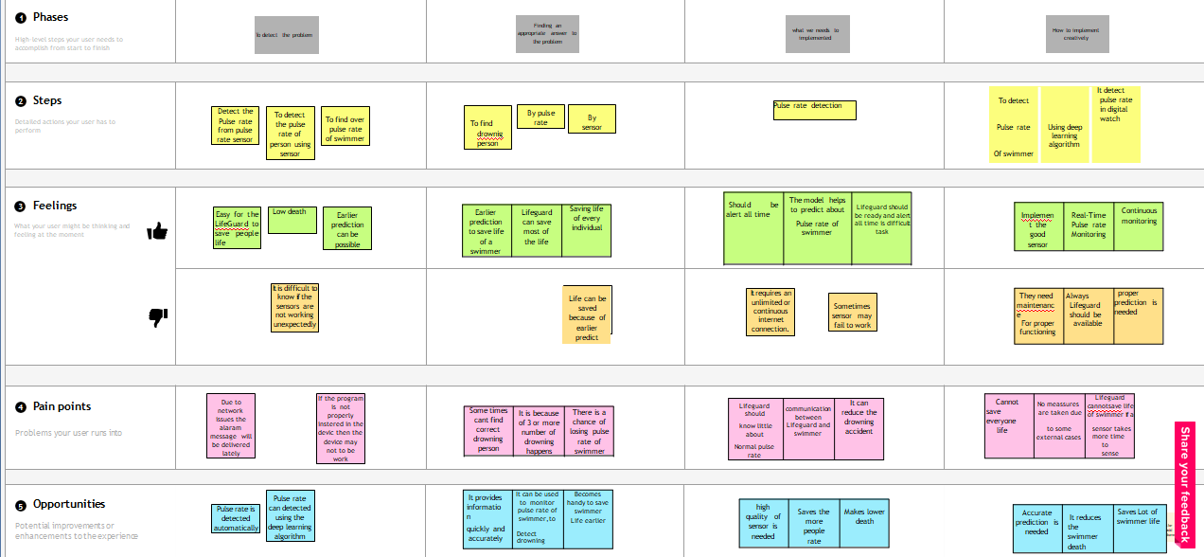
Project Design Phase-II Customer Journey Map
Date | 08 October 2022
Team ID | PNT2022TMID49453
Team Leader | Ms. Aswini RK (923819104007)
Team Member | Ms. Jananisree K (923819104015), Ms. Karpagam R (923819104018), Ms. Swasthikka R (923819104048).
Project Name | Virtual eye – lifeguard for swimming pools for active drowning
Maximum Marks

